Slide 1
Regression Coverage Heat-map
May 12, 2016

Slide 2
Executive Summary
Analyzed the regression test suite across the various PAS releases to identify the key functionality coverage (L2 capability) and created a Coverage matrix to illustrate the coverage The earlier version of the test coverage matrix that was reviewed in February 2016 focused on regression test coverage across the PAS 5, 6 and 7 releases Recent activity focused on enhancing the coverage heat-map in these areas: Regression coverage analysis for the property line of business for the PAS 8 release Exigen regression coverage for the property and auto lines of business Property state delta functionality Property common library functionality Roles & Privileges

Slide 3
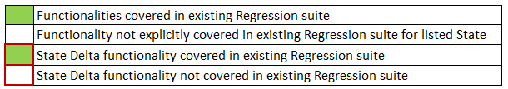
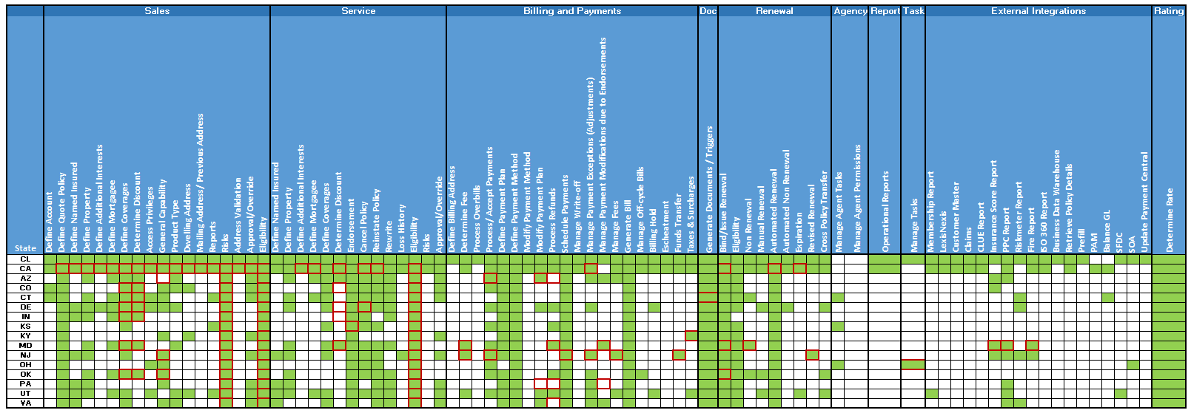
Coverage Analysis - Property
Heat Map of Functionalities (Function focused L2’s) and its coverage by states that are covered in the existing Regression Suite - State Delta highlighted
L2
State
The above analysis includes the coverage based on the Scenario/ Test case analysis for the below categories:
PAS2 to PAS8
Exigen Regression coverage
PAS 2,3 and 4 Optimization scenarios
Policy Life Cycle Scenarios

Slide 4
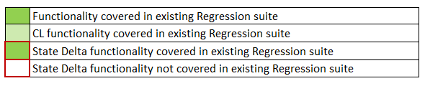
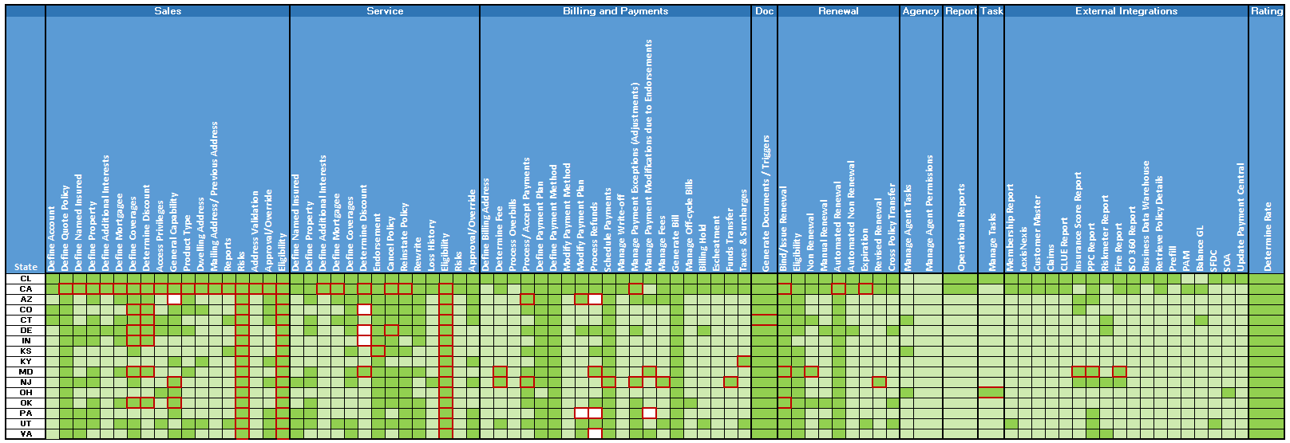
Coverage Analysis – Property (CL Functionality)
Heat Map of Functionalities (Function focused L2’s) and its coverage by states that are covered in the existing Regression Suite , with the Common Library functionality indicator
L2
State
The above analysis includes the coverage based on the Scenario/ Test case analysis for the below categories:
PAS2 to PAS8
Exigen Regression coverage
PAS 2,3 and 4 Optimization scenarios
Policy Life Cycle Scenarios

Slide 5

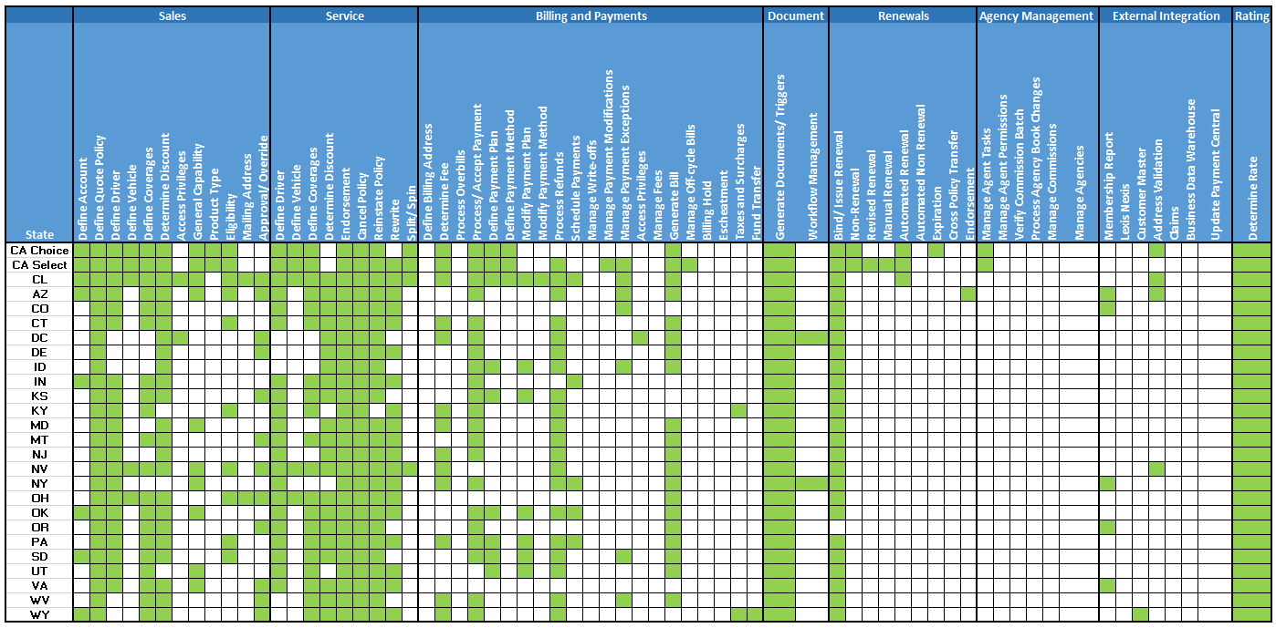
Work In Progress
Coverage Analysis - Auto
Heat Map of Functionalities (Function focused L2’s) and its coverage by states that are covered in the existing Regression Suite
L2
State
The above analysis includes the coverage based on the Scenario/ Test case analysis for the below categories:
PAS5 to PAS8
Exigen Regression coverage
PAS 2,3 and 4 Optimization scenarios
Releases prior to PAS5 has limited information on L2 as the mapping is available for most relevant L2’s only - Additional analysis might be required to determine all relevant L2’s

Slide 6
Coverage Analysis - Integrations
Heat Map of Interfaces and its coverage by states that are covered in the existing Regression Suite
L2
State
The analysis covers the test cases from PAS2 to PAS7
Single state out of CL/SCL User story will be tested. Here the assumption is that if a logic works for a particular state the implementation will not differ for other states and hence only one state will be used for testing. Above logic is not applicable for the delta functionality.
Following is the criteria to pick up the state in a release:
States getting rolled of in a particular release or
States rolled of in the previous release

Slide 7
Coverage Analysis – Roles & Privileges
Heat Map of Privileges corresponding to the Roles covered in the current Regression Test Suite
Privilege
Role

Slide 8
APPENDIX

Slide 9
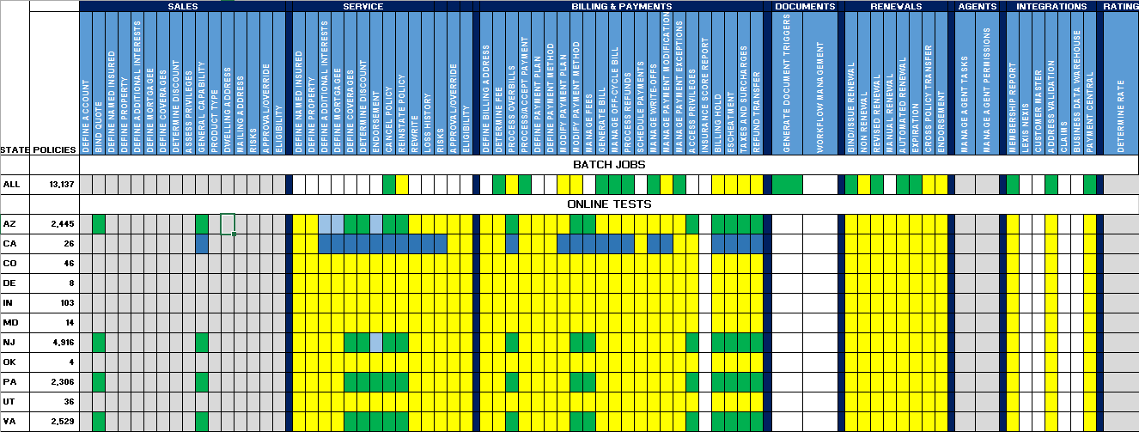
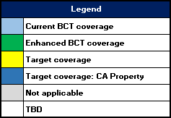
Coverage Analysis – Backward Compatibility Testing (Property)
Heat Map of BCT Tests and its coverage by states and the Proposed Target Coverage. Enhanced BCT tests cover 90% of the active property states based on policy counts; Additional tests are planned as California property policy volume grows in PAS.
L2
State
UI validations planned for Tests for AZ, NJ, PA & VA as these states currently account for >90% of PAS property policies
Proposed future coverage for CA Property is depicted in the heat map above
Regression test coverage not provided by BCT may be provided by other regression test streams
TBD items to be evaluated for applicability to batch or online BCT tests, state volume, or coverage through common library functionality

Slide 10
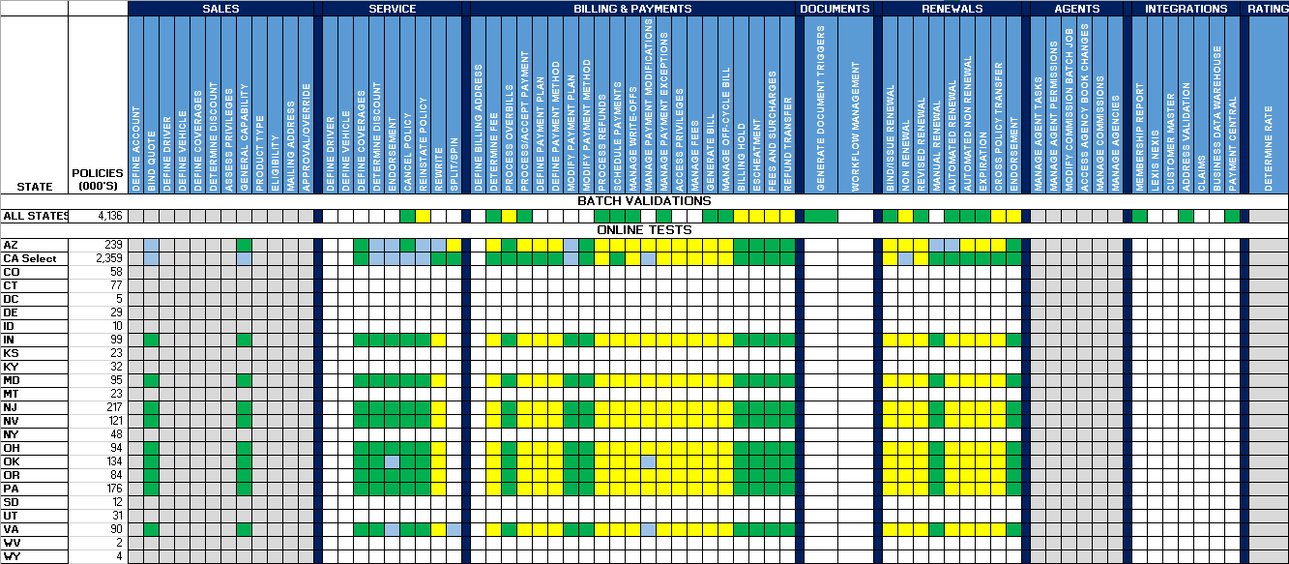
Coverage Analysis – Backward Compatibility Testing (Auto)
Heat Map of BCT Tests and its coverage by states and the Proposed Target Coverage. States included in Enhanced BCT tests account for over 90% of CSAA’s PAS automobile policy book of business.
L2
State
Additional coverage has been provided for CA Select as it accounts for 56% of Auto production policies
12 states (CO, CT, DC, DE, ID, KS, KY, MT, NY, SD, UT, WV, WY) have not been covered in the first phase of Enhanced BCT as they account for a relatively small percentage of CSAA automobile policy activity
Regression test coverage not provided by BCT may be provided by other regression test streams
TBD items to be evaluated for applicability to batch or online BCT tests, state volume, or coverage through common library functionality

Slide 11
Cross Policy Transfer Coverage
Analysis of coverage across Cross Policy Transfer functionality Vs Requirement availability for Property
Functionality | User Story Id | Coverage in Regression
AP After Renewal Offer - Effective Renewal Term | 15594, 20393 | Yes
AP After Renewal Offer - Effective Current Term | 15597, 20392 | Yes
AP Before Renewal Offer - Effective Current Term | 15586, 20367 | Yes
AP Before Renewal Offer - Effective Renewal Term | 15595, 20398 | Yes
RP After Renewal Offer - Effective Renewal Term | 15589, 20396 | Yes
RP After Renewal Offer - Effective Current Term | No Requirements | No
RP Before Renewal Offer - Effective Renewal Term | 15596, 20395 | Yes
RP Before Renewal Offer - Effective Current Term | No Requirements | No
Regression Test suite has a coverage for Cross Term transactions that involve AP Endorsement for current and renewal term. However, RP is covered only for renewal term as we do not have user story for RP during current term
Analysis of coverage across Cross Policy Transfer functionality Vs Requirement availability for Auto
Functionality | User Story Id | Coverage in Regression
Billing-Ability to reflect renewal bill in billing | 130-281CL | Yes
Ability to reflect renewal bill in billing - CA | FR200-270 | Yes
Requirements are very light on content

Slide 12
Risk Based Testing Selection Criteria
Guidelines for functionalities to be tested as part of Risk Based Testing
End to End scenarios covering multiple renewals covering all key business transactions of a policy life cycle stages - Cancelations, Reinstatement/ Rewrite, (typically at least until 2nd Renewal), using the most commonly roles used by Business in their day to day operations that complements the existing policy life cycle scenarios created by the Regression design team
New property state roll outs
Enhancement to existing user stories for states currently in production
Validation of Business critical functions (Billing / Endorsements (Out of Sequence endorsements))
Random Negative validations of Privileges and Task management user stories
Role based testing performed for validation of Privilege levels and validation of workflows or task/ activity hand-offs depending on authority levels
Business SME Recommendations/ Business Inputs considered for each release and new scenarios created/ existing scenarios leveraged based Business need. Some examples below:
Top 10 Billing Functionalities
Non-EMRO requirements validations
Employee Benefits Discount
UBI Testing
Additional testing on functional areas having high defect density based on Production defects analysis
Rules that require specific set of preconditions (e.g. Holiday logic)
Ad-hoc testing by adding additional validations to the existing scenarios to uncover new defects and avoid pesticide paradox
Validation of Business critical documents (Premium notices/ Premium receipts etc.)

Slide 13
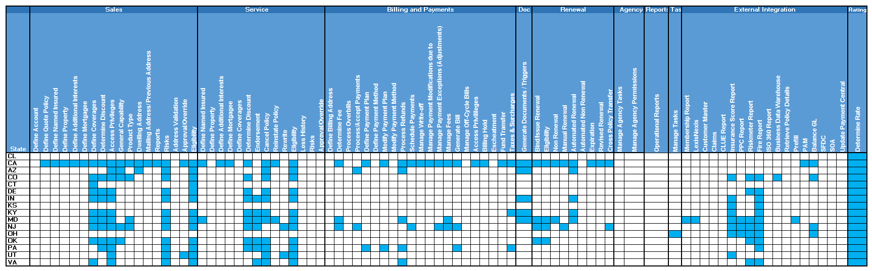
State-wise Delta (Property)
Heat Map of State-wise Deltas (Function focused L2’s) for the existing Regression suite (This slide is not indicative of the State-Delta Coverage)
L2
State

